Slide 1
DEPARTMENT OF AGADTANTRA VYAVHARA AYURVEDA & VIDHI VAIDYAKA
TOPIC : PRENATAL DIAGNOSTIC TECHNIQUIES ACT, 1994

Slide 2
INTRODUCTION
PNDT ACT ,1994 is an act of the parliament of INDIA enacted to stop female foeticides and arrest the declining sex ratio in India
The act banned prenatal sex determination

Slide 3
DEFINATION
Sex selection is any act of identifying the sex of the foetus and elimination of the foetus if its of unwanted sex.

Slide 4
Citation : ACT NO.57 OF 1994
Assented to : 20 SEPTEMBER 1994
Commenced : 1 JANUARY 1996
Enacted By : Parliament of INDIA
In 1988,the state of Maharashtra became the first in the country to ban prenatal sex determination through enacting the Maharashtra Regulation of Prenatal Diagnostic Techniques Act.

Slide 5
OBJECTIVES OF THIS LAW
Prohibition of sex selection
Regulate prenatal diagnostic techniques for detection of genetic or metabollic disorders or chromosomal abnormalities or certain congenital mal formations or sex linked disorders
Prevent misuse of such techniques for the purpose of sex determination of female foeticide.

Slide 6
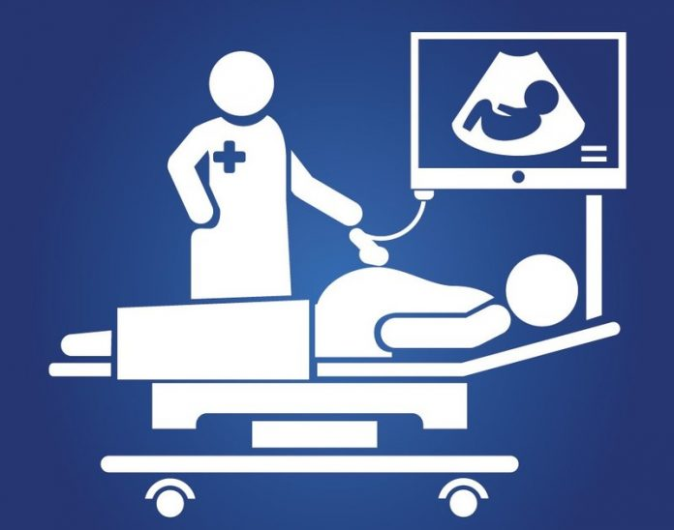
P
PRENATAL DIAGNOSTIC ACT INCLUDES :
ULTRASONOGRAPHY[USG]
FEOTOSCOPy
Test or analysis of :
Chorionic villi
Blood
Any tissue
Amniotic fluid

Slide 7
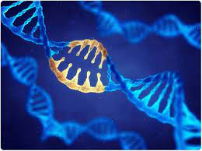
APPLICATION OF PNDT :
Genetic disorders
Metabolic disorders
Chromosomal abnormalities
Congenital abnornamalities
Heamoglobinopath
Sex linked disorders

Slide 8
WHEN CAN PNDT BE CONDUCTED
PREGNANT women has undergone spontaneous abortions
2. Pregnant women has been exposed to teratogenic agents like:
Drugs
Radiation
Infection
Chemicals
3. Pregnant women or spouse has family history of
Mental retardation
Physical abnormalities
Genetic diseases.

Slide 9
REGULATIONS FOR CLINICS & LABORATORIES
Every Genetic councelling center, Genetic labs / clinics has to be registered under the act .
should employ only qualified staff.
Prohibition on sale of machines to authrities who not registered under the act

Slide 10
AMENDMENT IN 2003
Pre-Natal Diagnostic Techniques Act, 1994 (PNDT), was amended in 2003 to The Pre-Conception and Pre-Natal Diagnostic Techniques (Prohibition Of Sex Selection) Act (PCPNDT Act) to improve the regulation of the technology used in sex selection.
Regulating the sale of the utrasound machines only to registered bodies.
Empowering authorities , civil courts for seizure, search, sealing of equipments.

Slide 11
PROHIBITION OF ADVERTISEMENT
As per sec22[1] : No person,organisation ,genetic councelling center,laboratories or clinic including clinic,labs or center havins ultrasound machine or any other technology capable of undertaking determination of sex of foetus will:
ISSUE
PUBLISH
DISTRIBUTE
COMMUNICATE
Any advertising in any form including internet regarding facilities of prenatal determination of sex .

Slide 12
PROHIBITION OF ADVERTISEMENT
No person, , will communicate the sex of the foetus to the pregnant woman or her relatives by words, signs or any other method.
Any person who puts an advertisement in the form of a notice, circular, label, wrapper or any document, or other media in electronic or print form or hoarding, wall painting, signal, can be imprisoned for up to three years and fine upto Rs. 10,000.

Slide 13
GUIDELINES FOR USING PNDT
Obtain written consent of pregnant women [form G]
Explain the pregnant women side effects of technologies & obtain written consent in any language she understands.
To give her a copy of written consent.

Slide 14
PUNISHMENTS
Offender to be punishable with fine of 10,000& extend upto 50,000
Imprisonment for a term of 5 years
Cancellation of registeration as a medical practitioner.

Slide 15
THANK YOU!….
Guided By : Dr. Yogesh Dehagaokar Sir
: Dr Akhilesh Deshmukh Sir
Made By : HARSHAL KATORE
Roll no : 27
BAMS 3rd YEAR [2017]

