Slide 1
Indication of Virechana Karma

Slide 2
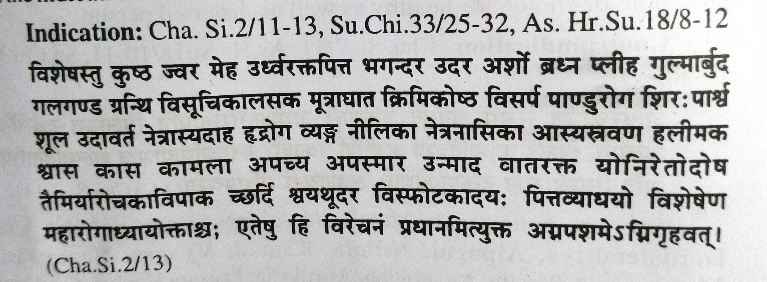

Slide 3
कुष्ठ जोर ज्वर मेह उर्ध्वग् रक्तपित्त, भगंदर उदर अर्श व्रघ्णा प्लीहा गुल्म अर्बुद गलगणड ग्रंथी विसुचिका अलसक मुत्राघात कृमिकोष्ठ विसर्प पांडू रोग शिरशुल पार्श्वशुल उदावर्त नेत्रदाह आस्यदाह हृद्रोग व्यंग नीलिका नेत्र स्त्राव नासास्त्राव हास्यस्त्राव हलीमक श्वास कमला अपची अपस्मार उन्माद, वात रक्त,योनी दोष, रेतो दोष,तिमिर आरोचक अविपाक छर्दी उदर क्षवतू विस्फोट

Slide 4
Dosh –
Utklishta pitta
Kaph samsruhta pitta
Pittasthangata alpa kApha , kaphsthangata Bahu Pitta , Pakwashaygata Pitta or Kapha Pitta
Pitta avruta vata , Kapha Avruta vata.
Charak advice that Tiryakgata Dosha should be taken back to Koshta , gradually by proper acts and after that elimination should be carried out. This denotes that Virechan is the treatment of choice in Tiryakgata Dosha bas seen in Kushta .

Slide 5
Dushya-
For Ras , Rakta etc vikara virechan Karma is described in direct or. Indirect way
In swastha
Purvakarma for Rasayana and vajikarana
Virechan is indicated in disorders like gulma -vatadikya, Kamala-Paittik, Gara-Tridoshaja, unmada –Tridoshaja, Kushta –Tridoshaja etc
From Above it’s clear that Virechan karma has specific actions on various conditions of all three Doshas
It is a procedure of choice for healthy as well as diseased person.

Slide 6
Contraindication

Slide 7
सुभग क्षतगुद मुक्तनाल , अधोग रक्तपित्त विलांघीत दुर्बलेंद्रिया अल्पाग्नी निरुदा कामादी व्यग्र , नवज्वर मदात्याय आध्मात अतिस्निग्धा अतिरुक्षा दारुण कोष्ठ गर्भिणी

Slide 8
Contraindication Reason
सुभग (ulceration in anal region ) सुभगस्य सुकुमारोक्तो दोष: स्यात(Bleeding P/R , Pain in precordial region etc.)
क्षतगुद (Injury to anal region). क्षते गुदे प्रणोपरोधकरी रूजां जनयेत(Gives rise to severe pain in the anal region)
मुक्तनाल (Anal in continence) मुक्तनालमतीप्रवृत्या हन्यात ( chances of Atipravrutti of Dosha’s)
अधोग रक्तपित्त (Spontaneous bleeding from rectal route and urethral route ) अधोभाग रक्तपित्तीन तद्वत (may worsen the condition)
वीलांघित दुर्बलेंद्रिय अल्पग्नि निरुढा (The person who had undergone langhana Niruha who is debilitated and has alpagni) औषघवेगं न सहेरन (Cannot tolerate the strain caused due to action of virechana dravyas)

Slide 9
कामादिव्याग्रम (usually active in sexual behaviours) न प्रवतरते कृच्छ्रेन वा प्रवर्तमानमयोगदोषानं कुर्यात,|,(chances of Ayoga doshas is observed)
अजीर्ण (Indigestion) आमदोष: (Formation of Amadosha’s)
नवज्वरी (Fever of recent origin) : अविपक्वान दोषानम न निरहरेद वातमेव च कोपयेत(Because of unripened state of Dosha’s there are chances of complication)
मदात्त्ययी (Alcoholic) मद्यक्षिणे देहे वायु प्रानोपरोधम कूर्यात (Body is weakened in alcoholics. Virechana karma is likely to predispose provocation of vata.)
आध्मात (Distension of abdomen) अधमतो वा पुरिषकोष्ठे निचीतो वायुविसर्पण सहसातिवृ तीव्रतरं मरणं वा जनयेत(Administration of Virechana may further cause aggravation of disease )

Slide 10
शल्यार्दिताभिहतयो (Traumatic injury). क्षते वायुरश्रीतो जीवितं हिंस्यात (Further aggravation of vata)
अतिस्निग्ध (over Oleation) अतियोगभयं भवेत (chances of Atiyoga are seen )
रुक्ष (Excessive dryness in the body ) वायु रग ग्रहम कुर्यात (Vitiation of vata)
दारुण कोष्ठ (Habitual constipated) विरेचनोद्धतादोष हृच्छूल पर्वभेदानाह अंगमर्द च्छर्दी मूर्च्छा
कलम आंजयित्वा प्राणान हनतु (Can lead to Ayoga , precordial pain , joint pain , Distension of abd , bodyache vomiting etc .)

