Slide 1
Essential diagnostic and therapeutic modern pharmacological agents required in Netra Chikitsa

Slide 2
Theraputic modern pharmacological agents
MODES OF ADMINISTRATION
Ocular pharmacotherapeutics can be delivered by four
methods: topical instillation into the conjunctival sac,
periocular injections, intraocular injections and
systemic administration.

Slide 3
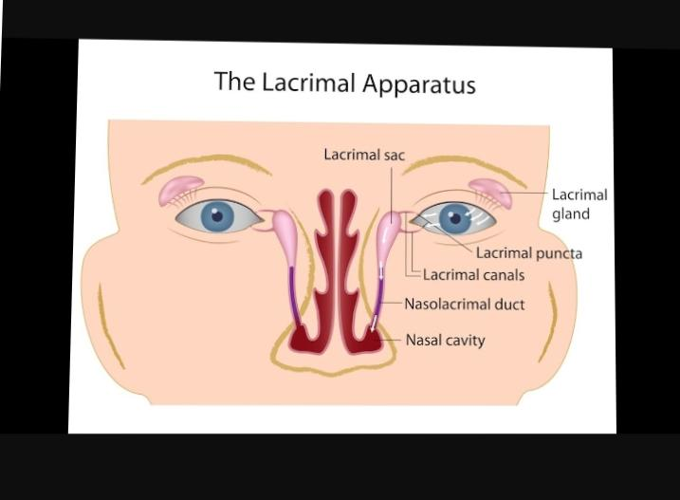
Usually size of one eye drop is 20–50 μl while cul-de-sac can hold only 7–10 μl volume which leads to spillage and/or nasolacrymal drainage.

Slide 4
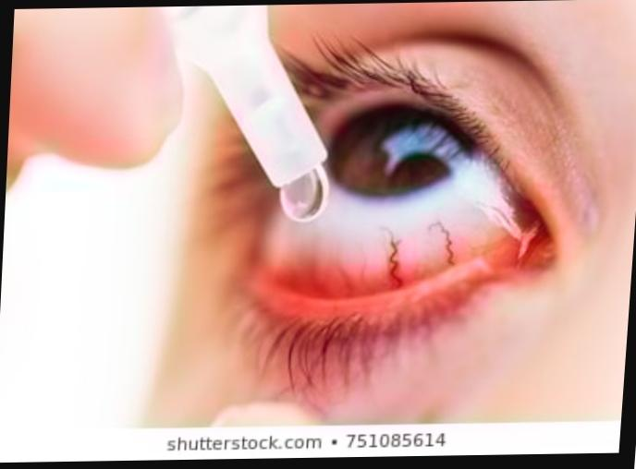
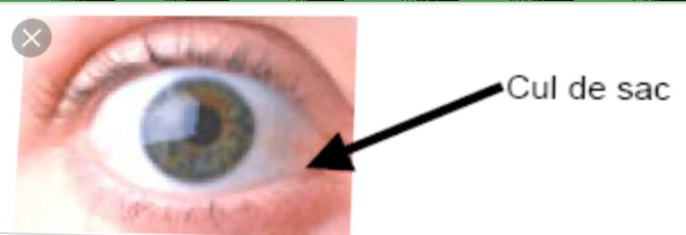
Eye drops
Application in the form of eyedrops
makes the drug available for immediate action but it
is quickly diluted by tears within about a minute.

Slide 5
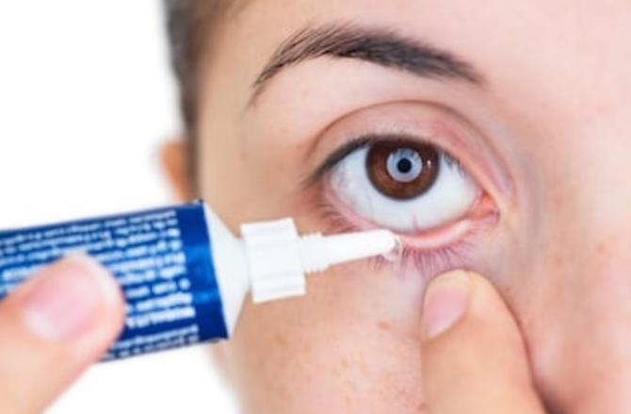
Eye ointment (oculenta or ung).
eye ointment increases
the bioavailability of the drug by increasing tissue
contact time and by preventing dilution and quick
absorption.

Slide 6
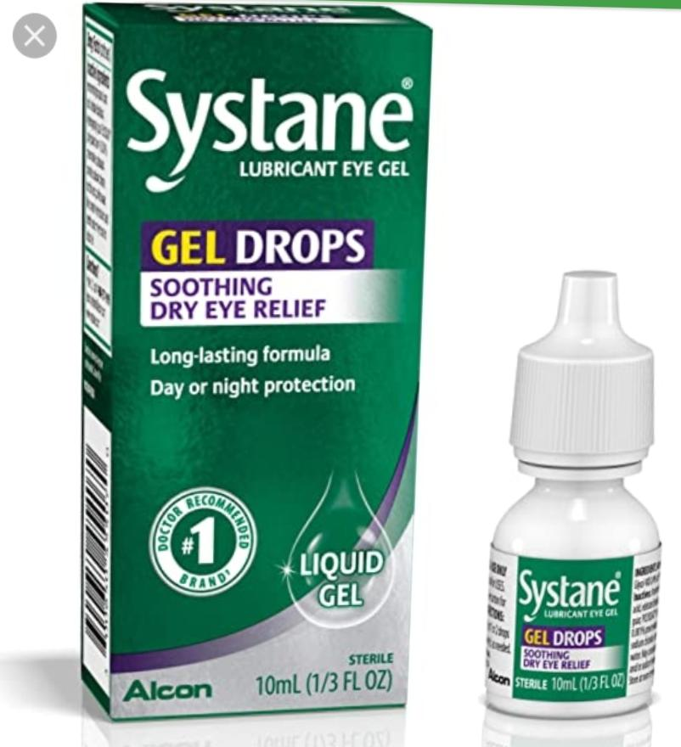
Gels.
These have prolonged contact time like
ointments and do not cause much blurring of vision.
However, they are costly and difficult to prepare.

Slide 7
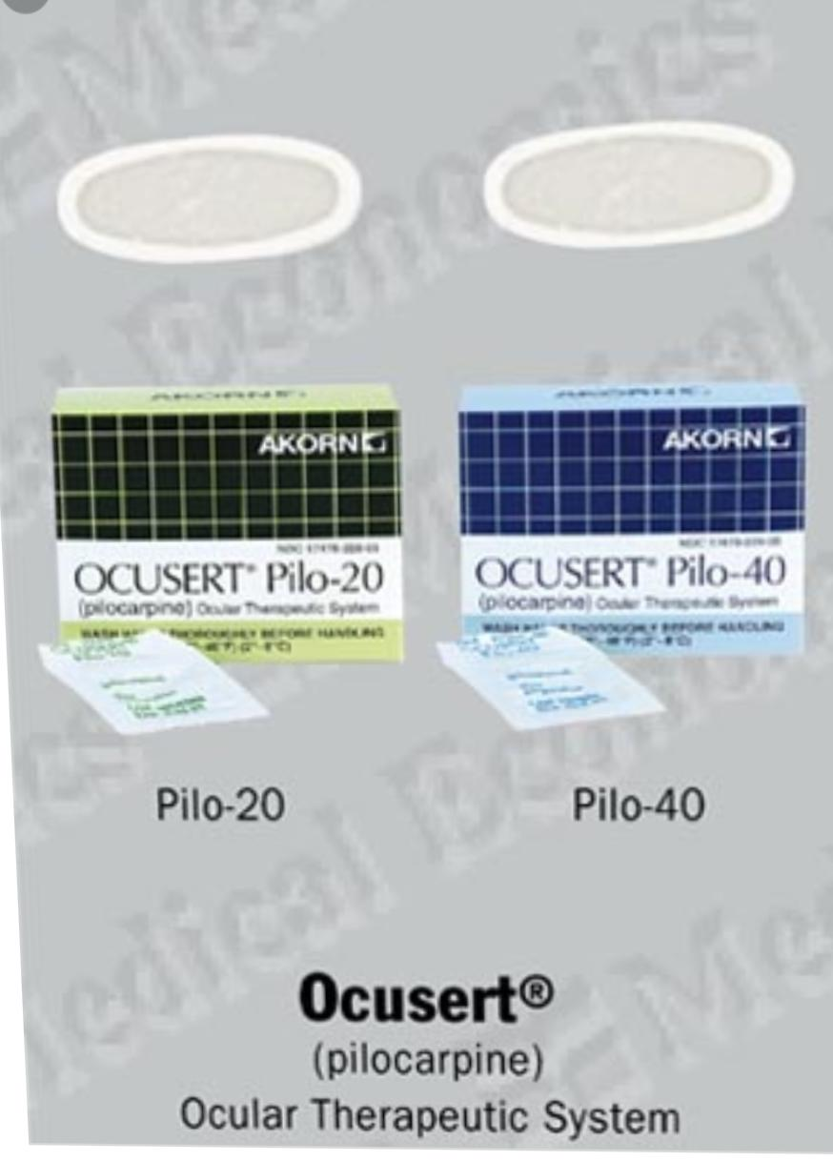
Ocuserts.
These form a system of drug delivery
through a membrane.

Slide 8
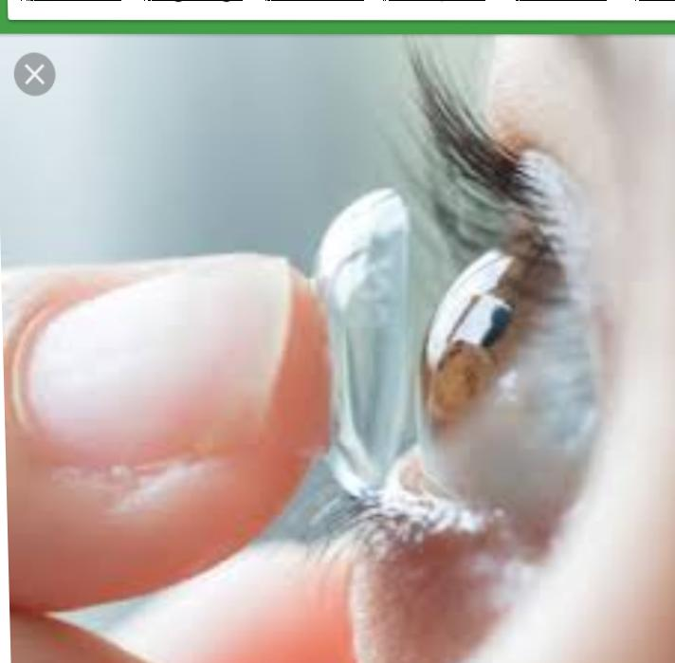
Soft contact lenses
These are very good for
delivering higher concentrations of drugs in
emergency treatment.

Slide 9
Periocular injections
These are not infrequently employed to deliver drugs.
These include subconjunctival, sub-Tenon,
retrobulbar and peribulbar injections.

Slide 10
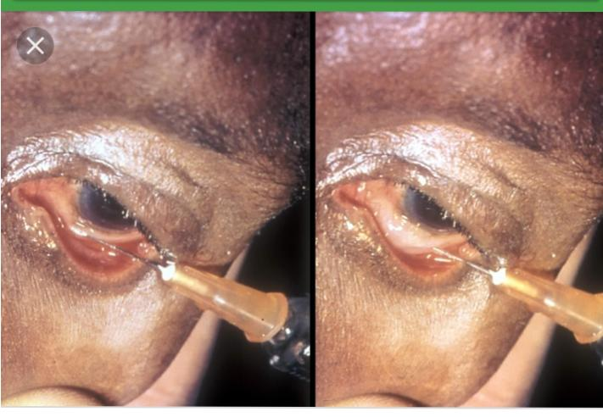
Subconjunctival injections. These are commonly
used to achieve higher concentration of drugs.
Further, the drugs which cannot penetrate the cornea
owing to large-sized molecules can easily pass
through the sclera.

Slide 11
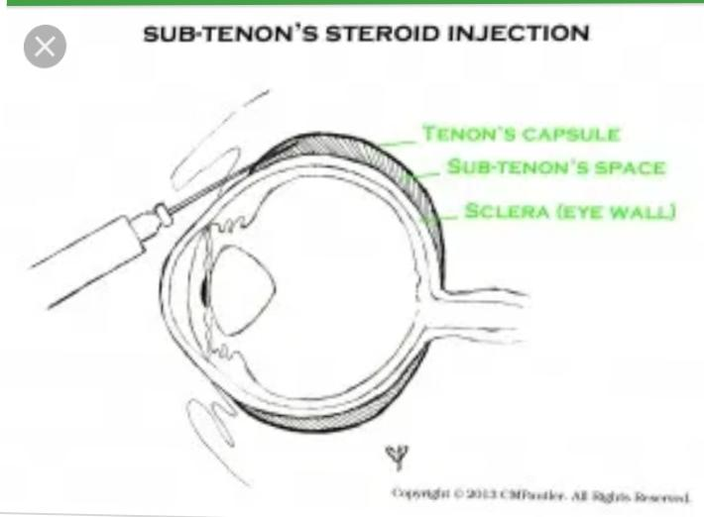
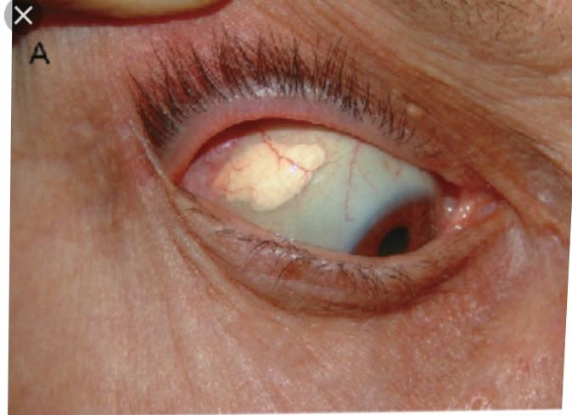
) Sub-Tenon injections. These are preferred over
subconjunctival injection. Anterior sub-Tenon
injections are used mainly to administer steroids in
the treatment of severe or resistant anterior uveitis.

Slide 12
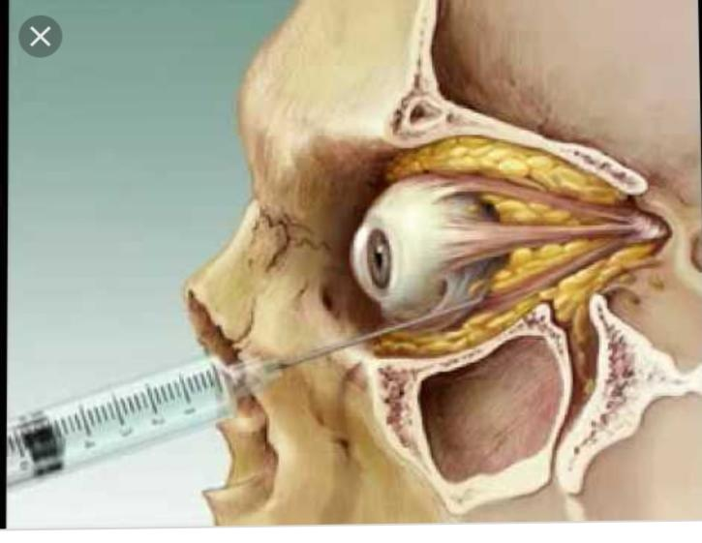
c) Retrobulbar injections. These are used to deliver
drugs for optic neuritis, papillitis, posterior uveitis
and also for administering retrobulbar block
anaesthesia.

Slide 13
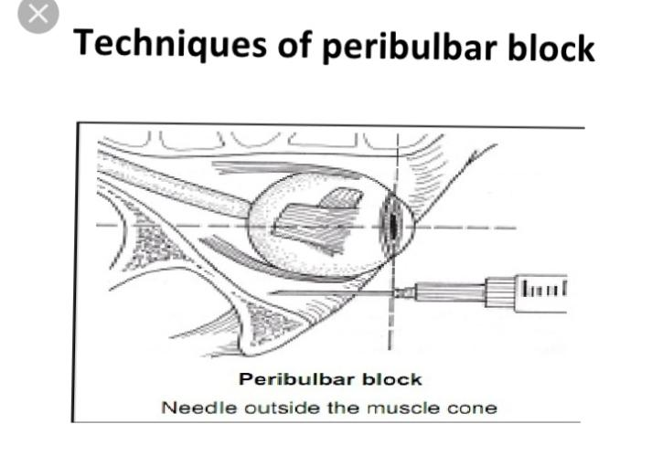
d) Peribulbar injections. These are now frequently
used for injecting anaesthetic agents. Peribulbar
anaesthesia has almost replaced retrobulbar and facial
block anaesthesia.

Slide 14
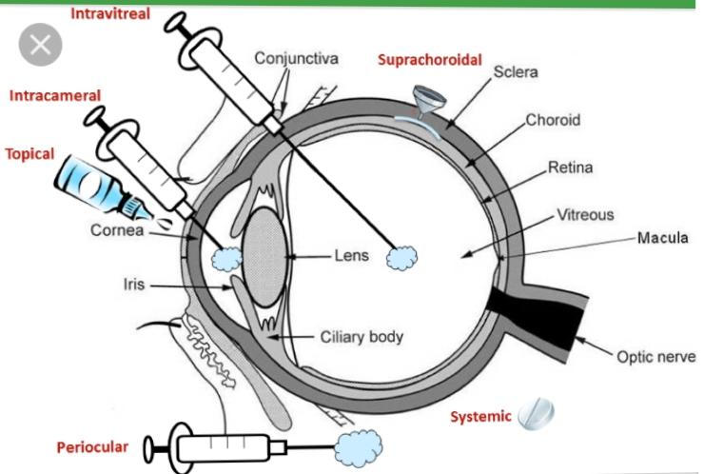
Intraocular injections
Such injections are made in desperate cases (e.g.,
endophthalmitis) to deliver the drugs in maximum
concentration at the target tissue. These include:
intracameral injection (into the anterior chamber),
and intravitreal injection (into the vitreous cavity).

Slide 15
Systemic administration
The systemic routes include oral intake and
intramuscular and intravenous injections. The
intraocular penetration of systemically administered
drugs mainly depends upon the blood-aqueous
barrier. The passage through blood-aqueous barrier
in turn is influenced by the molecular weight and the
lipid solubility of the drug.

Slide 16
Only low molecular weight drugs can cross this
blood-aqueous barrier. No passage is allowed to large-
sized molecules, such as penicillin. Out of the
borderline molecular weight drugs, those with high
lipid solubility can pass easily e.g., sulphonamides
have the same molecular weight as sucrose but are 16
times more permeable due to their lipid solubility.
Similarly, chloramphenicol being lipid soluble also
enters the eye easily.

Slide 17
COMMON OCULAR THERAPEUTICS
COMMON OCULAR THERAPEUTICS
The agents commonly used in ophthalmology include:
antibacterial, antiviral, antifungal, antiglaucoma,
corticosteroids, nonsteroidal anti-inflammatory drugs
(NSAIDs) and viscoelastic substances.

Slide 18
ANTIBACTERIAL AGENTS
Antimicrobial drugs are the greatest contribution of
the present century to therapeutics. As there are a
wide range of microorganisms, there are also specific
antibiotics for almost each organism. Depending on
the type of action, these can be either bacteriostatic
Or bactericidal..

Slide 19
Bacteriostatic: Capable of inhibiting the growth or reproduction of bacteria.
Bacteriocidal :: is a substance that kills bacteria. Bactericides are disinfectants, antiseptics, or antibiotics.

Slide 21
Bacteriostatic and Bacteriocidal action

Slide 23
Sulphonamide agents
These are bacteriostatic agents that act by
competing with PABA (para-aminobenzoic acid)
which is essential for the bacterial cell nutrition. Thus,
they prevent susceptible microorganisms from
synthesizing folic acid.

Slide 24
Beta-lactam antibiotics
These antibiotics have a beta-lactam ring. The two
important groups are penicillins, and cephalosporins.
All beta-lactam antibiotics act by interfering with the
synthesis of bacterial cell wall.

Slide 25
Aminoglycosides
These are bactericidal and act primarily against gram-
negative bacilli. These are not absorbed orally,
distributed mainly extracellularly and are excreted
unchanged in the urine. These are ototoxic and
nephrotoxic. Certain aminoglycosides are too toxic
for systemic use and hence used only topically Eg. Gentamicin , Tobramycine; Amikacine .

Slide 26
Tetracyclines
These are broad-spectrum bacteriostatic agents with
a considerable action against both gram-positive and
gram-negative organisms as well as some fungi,
rickettsiae and chlamydiae. This group includes
tetracycline, chlortetracycline and oxytetracycline.

Slide 27
Chloramphenicol
It is also a broad-spectrum antibiotic, primarily
bacteriostatic, effective against gram-positive as well
as gram-negative bacteria, rickettsiae, chlamydiae and
mycoplasma.
Its molecule is relatively small and lipid soluble.
Therefore, on systemic administration, it enters the
eye in therapeutic concentration. Topically it is used
as 0.5% eyedrops

Slide 28
Polypeptides
These are powerful bactericidal agents, but rarely
used systemically due to toxicity. Clinically used
polypeptides are polymyxin B, bacitracin, colistin and
tyrothricin.
1. Polymyxin B and colistin. These are active
against most gram-negative bacteria, notably
Pseudomonas.
2. Neosporin (neomycin-polymyxin-bacitracin). It is
an effective broad-spectrum antimicrobial but
suffers the disadvantage of a high incidence (6-
8%) of sensitivity due to neomycin.

Slide 29
Fluoroquinolones
Fluoroquinolones are potent synthetic agents having
broad spectrum of activity against gram-positive and
gram negative-organisms.
Mechanism of action. Fluoroquinolones are
bactericidal drugs. These inhibit the bacterial DNA
synthesis.
Preparations. Fluroquinolones by convention have
been grouped into four generations

Slide 31
Anti Viral

Slide 33
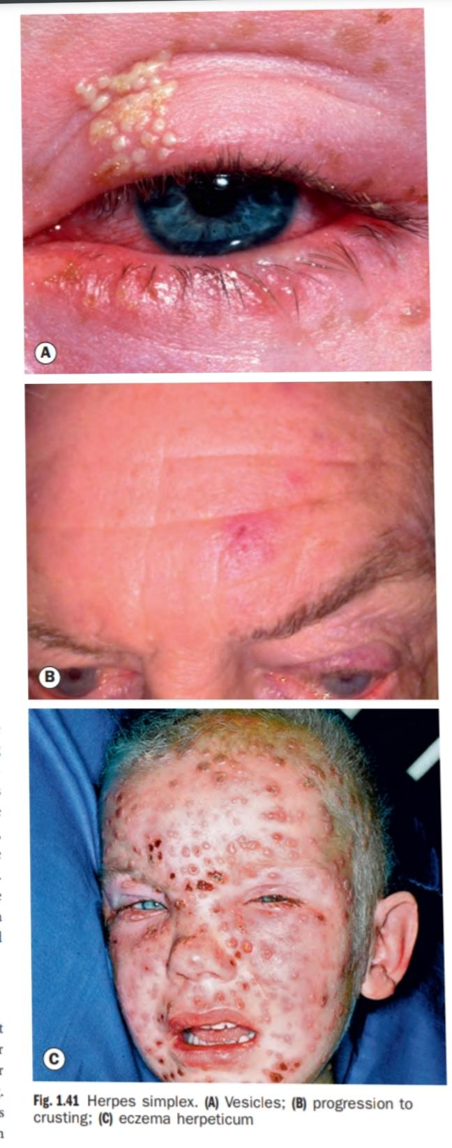
ANTIVIRAL DRUGS
These are more often used locally in the eye.
Currently available antiviral agents are virostatic.
They are active against DNA viruses; especially
herpes simplex virus. Antiviral drugs used in
ophthalmology can be grouped as below:
For herpes simplex virus infection
Idoxuridine
Vidarabine
Trifluridine
Acyclovir
Famiciclovir

Slide 34
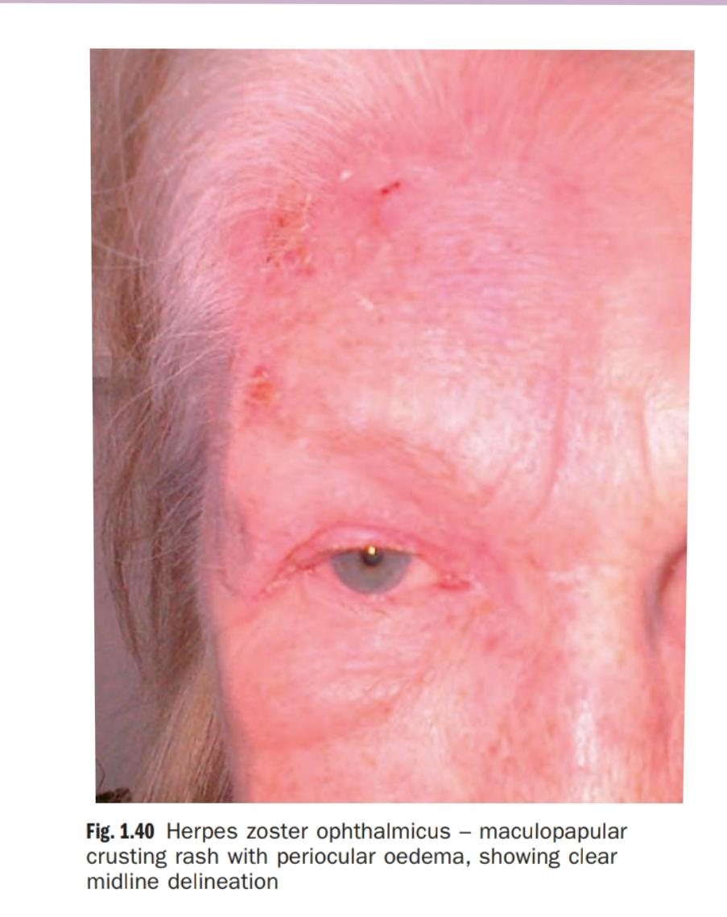
For herpes zoster virus infection
Acyclovir
Famiciclovir
Valaciclovir
Vidarabine
Sorvudine

Slide 35
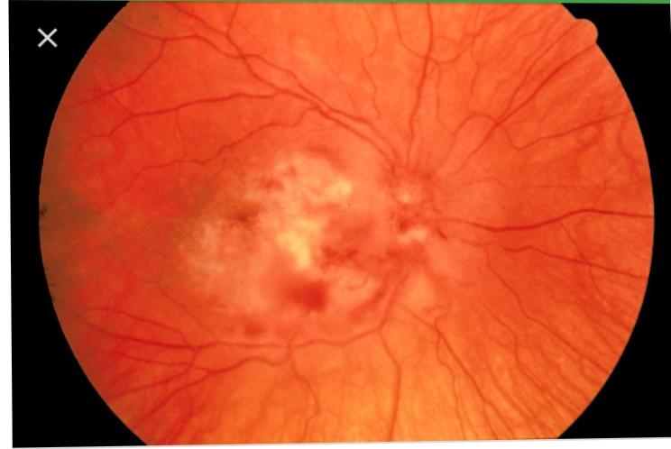
For CMV retinitis
Ganciclovir
Foscarnet
Zidovudin
Non selective
Interferons
Immunoglobulins

Slide 36
Viral keratitis

Slide 37
Acyclovir (Acycloguanosine
). It has proved to be
an extremely safe and effective agent and is effective
in most forms of herpes simplex and herpes zoster
infections.
Mechanism of action: It inhibits viral DNA,
preferentially entering the infected cells, with little
effect on normal cells. It penetrates into deeper layers
and thus is very effective in stromal keratitis.
Preparation. It is available as 3 percent ophthalmic
ointment and also as tablet for oral use and injection
for intravenous use.

Slide 38
Indications and doses: (a) Topical 3 percent ointment
is used 5 times a day for epithelial as well as stromal
herpes simplex keratitis (b) Oral acyclovir four tablets
of 200 mg each, 5 times a day for 5-7 days, may be
considered in following situations: (i) After
penetrating keratoplasty in patients suffering from
herpes simplex keratitis. (ii) Recalcitrant stromal or
uveal disease caused by HSV. (iii) To reduce ocular
complications of keratitis and uveitis in herpes zoster
ophthalmicus. Side-effects: A few cases show slight
punctate epithelial keratopathy which ceases once
the drug is stopped.

Slide 39
Valaciclovir. It is used for treatment of herpes
zoster ophthalmicus in a dose of 500-700 mg TDS for
7 days. It is as effective as acyclovir in acute disease
and is more effective in reducing late neuralgia.

Slide 40
Famiciclovir. Its use, dose and effectivity is similar
to valaciclovir.
8. Interferons. These are non-toxic, species-specific
proteins possessing broad-spectrum antiviral activity.
However, it is still not available for commercial use.
9. Immunoglobulins. These preparations may be
useful in the treatment or prophylaxis of certain viral
diseases especially in patients with immune
deficiencies.

Slide 41
10. Ganciclovir. It is used for the treatment of CMV
retinitis in immunocompromised individuals. Dose: 5
mg/kg body weight every 12 hours for 2-3 weeks,
followed by a permanent maintenance dose of 5 mg/
kg once daily for 5 out of 7 days.
11. Foscarnet (Phosphonoformic acid; PFA). It is
as effective as ganciclovir in the treatment of CMV
retinitis in AIDS patients.
12. Zidovudin (azidothymidine; AZT). It has been
recently recommended for selected AIDS patients with
non-vision threatening retinitis who have no evidence
of systemic CMV infection.

Slide 42
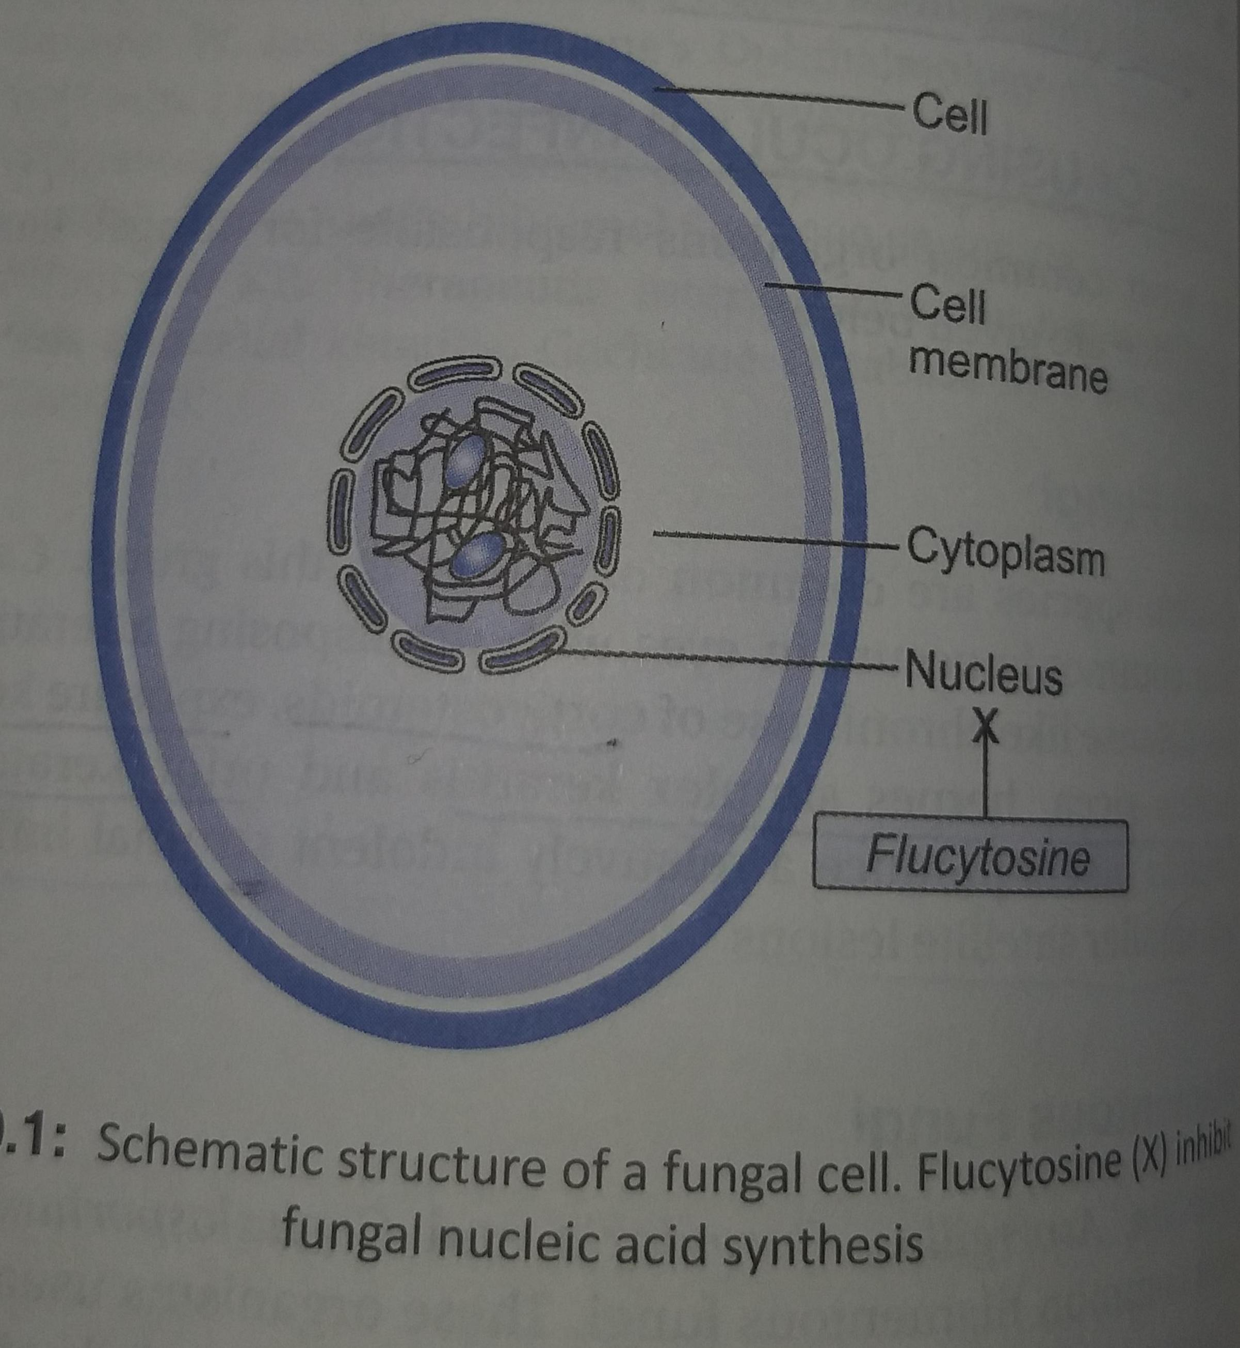
Cellular Structure of Fungi

Slide 43
Fungicidal
Killing the fungal cells – for example, by affecting a substance in the cell walls, causing the contents of the fungal cells to leak out and the cells to die
fungistatic
preventing the fungal cells growing and reproducing

Slide 44
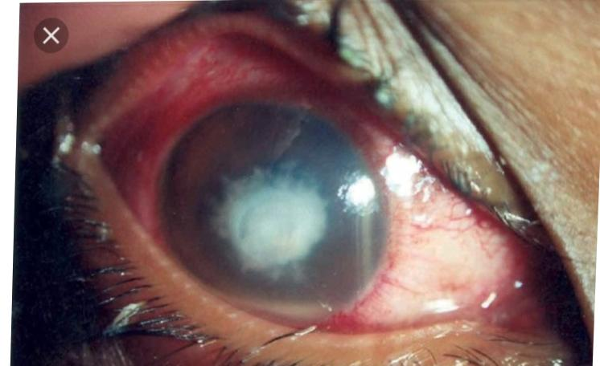
OCULAR ANTIFUNGAL AGENTS
broadly classified
on the basis of their chemical structure into polyene
antibiotics, imidazole derivatives, pyrimidines and
silver compounds.

Slide 45
Polyene antifungals
Streptomyces and consist of a large, conjugated,
double-bond system in a lactose ring linked to an
amino acid sugar.

Slide 46
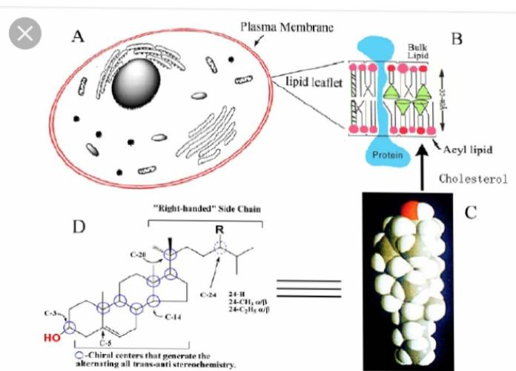
Mechanism of action.
They work by binding to the
sterol groups in fungal cell membranes, rendering
them permeable. This occurrence leads to lethal
imbalances in cell contents

Slide 47
Nystatin.
Fungistatic
0.3% eye Ointment
Candida or Aspergillus

Slide 48
Amphotericin B
Fungistatic or fungicidal
0.3% eye drops
Amphotericin B may be given intravitreally or/
and intravenously for treatment of intraocular
infections caused by Candida, Histoplasma,
Cryptococcus and some strains of Aspergillus

Slide 49
Natamycin
broad-spectrum
antifungal drug having activity against Candida,
Aspergillus, Fusarium and Cephalosporium.
Topical application of 5 percent

Slide 50
Imidazole antifungal drugs
miconazole,
clotrimazole, ketoconazole, econazole and
itraconazole.

Slide 51
Miconazole. It possesses a broad antifungal
spectrum and is fungicidal to various species of
Candida, Aspergillus, Fusarium, Cryptococcus,
Cladosporium, Trichophyton and many others.
Topical (1%) and subconjunctival (10 mg)
application of miconazole produces high levels of
the drug in the cornea which is more dramatic in
the presence of epithelial defect.

Slide 52
Clotrimazole. It is fungistatic and is effective
against Candida, Aspergillus and many others.
Its 1 percent suspension is effective topically
and is the treatment of choice in Aspergillus
infections of the eye.

Slide 53
Econazole. It also has broad-spectrum antifungal
activity and is used topically as 1 percent
econazole nitrate ointment. Becaue of its poor
intraocular penetration, it is effective only in
superficial infections of the eye

Slide 54
Ketoconazole. It is effective after oral
administration and possesses activity against
common fungi. It is given as single oral dose of
200-400 mg daily up to at least one week after the
symptoms have disappeared. It is an adjunctive
systemic antifungal agent in fungal keratitis
complicated by endophthalmitis.

Slide 55
Fluconazole. It is fungistatic drug active against
Candida, Aspergillus and Cryptococcus. It is
available for oral use (50-100 mg tablets) and also
for topical use (0.2% eyedrops).

Slide 56
Itraconazole. It is prescribed for treatment of
fungal infections caused primarily by Aspergillus,
Histoplasmosis, Blastomycosis. It has moderate
effect against Candida and Fusarium infections.
It is available for oral and topical use. Oral dose
is 200 mg twice daily for a week. Topically it is
used as 1% eye drops.

Slide 57
Silver compound
Combination of silver with sulfonamides and with
other anti-microbial compounds significantly
increases the activity against bacterial and fungal
infections. In this context several silver compounds
have been synthesized. Most frequently used is silver
sulphadiazine which is reported to be highly effective
against Aspergillus and Fusarium species.

Slide 58
Dilator pupillae and Sphincter Pupillae Muscle

Slide 59
MYDRIATICS AND CYCLOPLEGICS
Mydriatrics are drugs only dilate the pupil.
Cycloplegics are the drugs which cause paralysis of
accommodation and dilate the pupil.

Slide 61
ANTI-GLAUCOMA DRUGS Classification A. Parasympathomimetic drugs (Miotics) B. Sympathomimetic drugs (Adrenergic agonists) C. β-blockers D. Carbonic anhydrase inhibitors E. Hyperosmotic agents F. Prostaglandins G. Calcium channel blockers

Slide 62
Parasympathomimetic drugs (Miotics)
Parasympathomimetics, also called as cholinergic
drugs, either imitate or potentiate the effects of
acetylcholine.

Slide 63
Classification
1. Direct-acting or agonists e.g., pilocarpine.
2. Indirect-acting parasympathomimetics or
cholinesterase inhibitors:
3. Dual-action parasympathomimetics,

Slide 64
Mechanism of action
1. In primary open-angle glaucoma the miotics
reduce the intraocular pressure (IOP) by
enhancing the aqueous outflow facility. This is
achieved by changes in the trabecular meshwork
produced by a pull exerted on the scleral spur by
contraction of the longitudinal fibres of ciliary
muscle.
2. In primary angle-closure glaucoma these reduce
the IOP due to their miotic effect by opening the
angle. The mechanical contraction of the pupil
moves the iris away from the trabecular meshwork.

Slide 65
B. Sympathomimetic drugs
Sympathomimetics, also known as adrenergic
agonists, act by stimulation of alpha, beta or both
the receptors.

